Slide 1

CAMPAIGNER SURVEY RESULTS
2017
www.smk.org.uk
@SMKCampaigners

Slide 2

About you.
Who responded?

Slide 3
151 individuals
78% in paid job roles

Slide 5
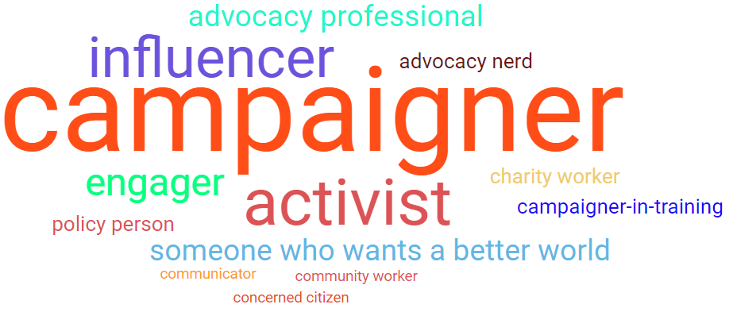
What words did they use to describe themselves?

Slide 8
The campaign environment.
What did they tell us?

Slide 12
What do you think are the current threats to the legitimacy of campaigning?

Slide 13
How has the recent environment around campaigning affected your own organisation or group in the last 3 years?

Slide 15
If you said yes, why?
Restricted civil society space.
Heavily occupied space and increasing campaigner apathy.
Fear of reprisals.
Funding is more competitive, campaigning can threaten certain Funders.
Continuous negative discourse from media and people in power.
The lobbying Act.
Political climate and agenda has made less opportunities to campaign.
Drowned out by media interests and Brexit.
Public perception and lack of resources.
Public criticism has led to great scepticism within and outside organisations.

Slide 17
If you said yes, why?
Having a solid united group of core volunteers, with the same vision and appetite for change.
Putting user's voices first.
Social networks and the internet.
More coalitions formed.
There is a public appetite that things need to change.
Organisations such as SMK, petition sites, Liberty, Medical Justice etc increasing visibility locally and nationally.
Sharing success stories.
There is a lot more to campaign about!
Senior figures inside NGOs that continue to campaign publicly explaining why & how.

Slide 18
What do you think that VCSE organisations should be doing to improve the environment for campaigning?
Providing tools for people to take meaningful actions at a local level; working together to challenge barriers to campaigning.
Putting user's experiences and voices at the forefront of their work.
Increase and support collaboration.
Championing campaigning and related activity.
Be braver, speak out and campaign against injustice, be comfortable with making people uncomfortable.
Tell their story better.
Be more politically impartial to reach more people.
Continue sharing information, experience and stories.
Highlighting the importance of campaigning as a mechanism of positive social change- which in turn improves life chances and society at large.

Slide 20
Support for campaigners.
What did they tell us?

Slide 21
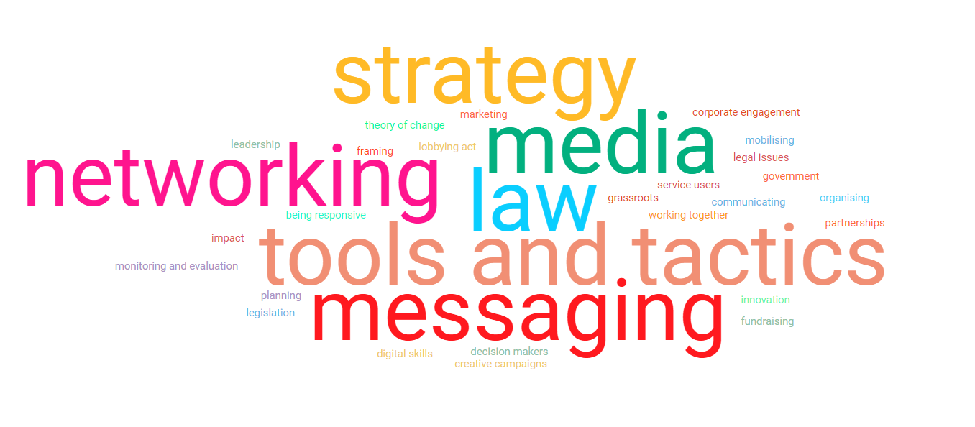
Some of the key words used to describe the areas of support that campaigners. need.

Slide 22
What kinds of training and support do you think would help your campaigning activities in the future?

Slide 23
What kinds of training and support might help you develop your own personal capacity and that of your organisation?

Slide 24
How would you like that support?

Slide 29
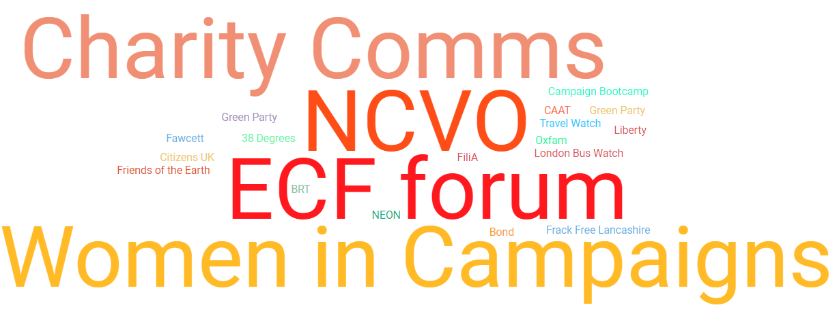
Are you a member of any existing campaign groups?

